Slide 1
Introduction to Python

Slide 2
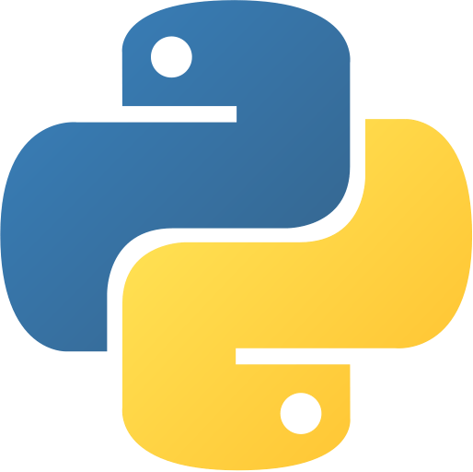
Python
A Modern Programming Language
Focuses on ‘scripting’
Interpreted
Takes another program to run the code
Common Uses
Research
Data science
Machine learning and Artificial Intelligence
Web development (backend)
Full applications and games
Becoming more common

Slide 3
Programs
Are a set of instructions
Like Cooking (common/historical analogy)
Like following a how-to guide
A computer only does what you tell it
It can’t guess
It can’t assume
It follows the instructions
for better or worse
Line by line, unless we say otherwise

Slide 4
Python Basics
Variables
Allow you to store information
puppyCounter = 100
puppyName = “Cerberus”
puppyName = ‘Cerberus’ #also allowed, but we will often use double quotes for Strings
Anything after the # sign is a comment, so not an instruction!
Output / Printing to the screen
print(“Ada Lovelace was the first programmer”)
print() signifies a function – that does the work for you!
code reusability
Input – From the console / client
input(“Who was the first programmer”)
But… We need to store the value!
answer = input(“Who was the first programmer”)

Slide 5
Let’s Look At Some Code!
answer = input(“Who was the first programmer?”)
print(answer + “ was the first programmer.”)

